Slide 1

TOTAL TECHNOLOGY
REPORTLAB COMPLETE TUTORIAL
Hyperlink markup
Part 20

Slide 2
Different markup:
<b> or <strong> - bold <i> - italicize <u> - underline <a href> - Adding a link <a name> - Adding an anchor <strike> - Strike-through <br/> - line break
TOTAL TECHNOLOGY

Slide 3
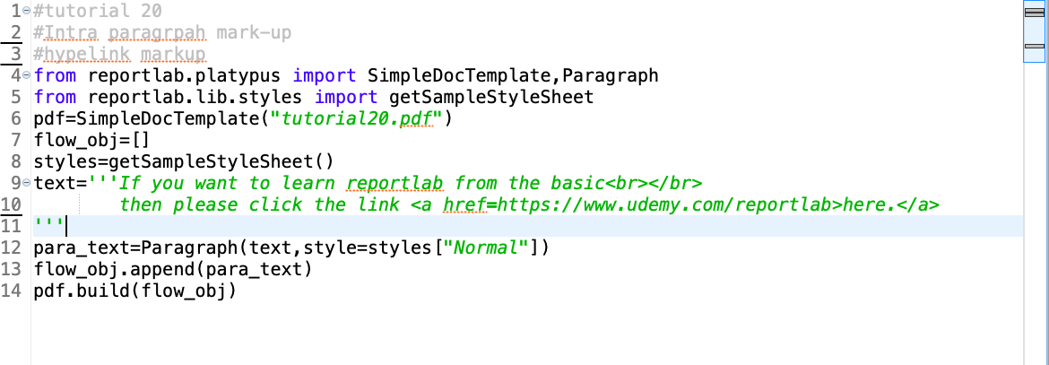
How to create hyperlink using href markup
TOTAL TECHNOLOGY

Slide 4
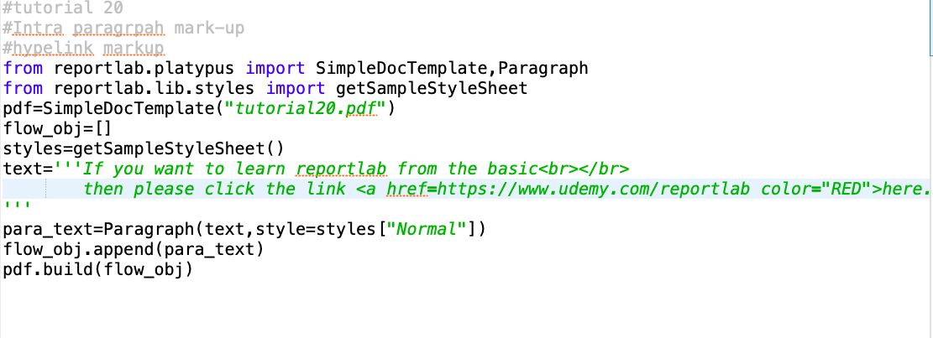
How to create hyperlink using href markup with color:
TOTAL TECHNOLOGY

Slide 5
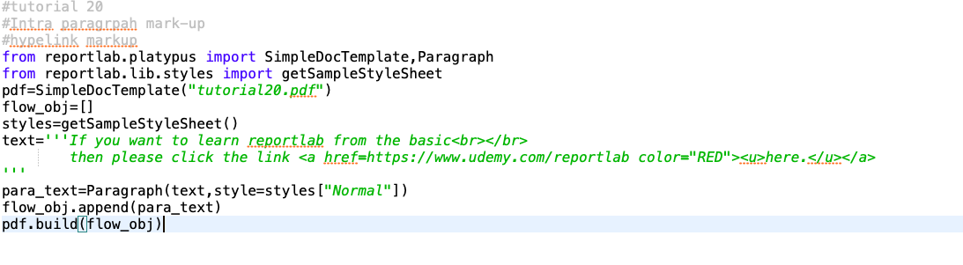
How to create hyperlink using href markup with color & underline markup:
TOTAL TECHNOLOGY

